Slide 1


Health Economics Lecture #11
Topic: Budget Impact Analysis
Prepared by Jacob Smith, Trent University

Slide 2
Learning Objectives
In this lecture we will discuss:
An Introduction to Budget Impact Analysis.
Cost Effectiveness League Tables.
Funding Decisions with the League Table
Budget Impact Analysis- Static Models.
Goal of this Lecture:
Introduce Decision Making with ICERs.
Introduce Scenario Analysis and show the basics of budget impact analysis.

Slide 3
An Introduction to Budget Impact Analysis.

Slide 4
What is Budget Impact Analysis
Budget Impact Analysis is a procedure conducted to estimate the financial impact of deciding to fund a new treatment.
It is done to address the question of it is feasible to agree to fund a treatment.
Budget impact analysis is of interest to specific third-party payers as funding decisions are binary (they are yes-no decisions).
Budget Impact Analysis is often based on many assumptions about uptake among patients and how treatment mixes may change.

Slide 5
Why Budget Impact Analysis is Important.
Suppose we have a list of possible treatments to fund with their computed ICER, cost per patient and the size of the patient population.
Cost effectiveness analysis on its own tells us to fund the treatments that are at or below a particular threshold.
However, this rule on its own does not tell us if funding a treatment is feasible.
Budget Impact Analysis tells us if the funding of a treatment is feasible for a particular decision maker.
Treatment | Unit Cost (per patient) | ICER (Cost per QALY gained) | Patient Type | Patient Population Size
Treatment A | $12,000 | $45,000/QALY | Adults with moderate rheumatoid arthritis | 150,000 patients
Treatment B | $8,500 | $35,000/QALY | Patients with stage II hypertension | 2,100,000 patients
Treatment C | $25,000 | $95,000/QALY | Individuals with metastatic melanoma | 70,000 patient
THE ICER IS IMPORTANT, BUT FEASIBILITY IS AS, IF NOT MORE, IMPORTANT.

Slide 6
Budget Impact Analysis VS Cost Effectiveness Analysis
CEA
Used to determine the value for money associated with a treatment.
Key Statistics Computed: ICER and the Probability of Cost Effectiveness
BIA
Used to determine the Feasibility of funding a particular treatment.
Key Statistics Computed: Expected Budget Impact, Scenario Analysis for High and Low Uptake Cases.
Tells us if we are getting a “good deal” by funding a treatment
Tells us if paying for a treatment is affordable.
Computed Statitic is useful and generalizable to many different Environments
Estimates are often useful to the studied budget holder. Model structure can be generalized but not estimates.

Slide 7
Cost Effectiveness League Tables.

Slide 8








The Payer’s Problem
Analysts conduct cost effectiveness analysis of drugs that have passed clinical trials.
$$λ_{1}$$
$$λ_{2}$$
$$λ_{3}$$

Slide 9

The Payer’s Problem
These ICERs are submitted in the form of funding proposals to the Ministry of Health.
$$λ_{1}$$
Ministry of Health
$$λ_{2}$$
$$λ_{3}$$

Slide 10




The Payer’s Problem
The Ministry of Health Must Decide Which Treatments to Fund and Which
Ones to Reject.
$$λ_{1}$$
Ministry of Health
$$λ_{1}$$
$$λ_{2}$$
$$λ_{3}$$
$$λ_{2}$$
$$λ_{3}$$
This is done often with the use of Cost Effectiveness League Tables.

Slide 11
The Cost Effectiveness League Table
The Cost Effectiveness League Table, is list of treatments with their corresponding ICER and other information.
It is a simple way to organize decision making around which treatments to fund and which treatments not to fund.
While there can be lots of information included in a league table the core is just a list of treatments with their ICERs organizes from smallest to largest.
Rank | Intervention | ICER (CAD per QALY)
1 | Drug A | $11,333/QALY
2 | Drug B | $22,000/QALY
3 | Surgical Procedure | $32,500/QALY
4 | Advanced Biologic | $133,333/QALY
5 | Gene Therapy | $197,059/QALY

Slide 12
Funding Decisions with the League Table

Slide 13
Funding Decisions with the League Table
To determine which treatments obtain funding and which do not, we consider two circumstances.
The case where the budget is defined.
The case when the budget is not defined.
When we have a defined budget, the optimal list of treatments to fund is based on the following rule: 1. Fund the Treatment with the Smallest ICER and subtract the estimated budget impact from the defined budget. 2. At the next smallest ICER look at the budget impact and if the treatment is feasible fund it, otherwise stop. 3. Repeat until the budget is exhausted.

Slide 14
Funding Decisions with a Fixed Budget.
Rank | Intervention | ICER (CAD per QALY) | Size of Eligible Population | Unit Cost (CAD) | Budget Impact
1 | Drug A | $11,333/QALY | 12,000 patients | $1,200 | 14.4 Million CAD
2 | Drug B | $22,000/QALY | 7,500 patients | $4000 | 30 Million CAD
3 | Surgical Procedure | $32,500/QALY | 3,200 patients | $9000 | 28.8 Million
4 | Advanced Biologic | $133,333/QALY | 1,100 patients | $20,000 | 22 Million
5 | Gene Therapy | $197,059/QALY | 150 patients | $65,000 | 9.75 Million
Question: Suppose we have a Budget of 50 Million Dollars?
Which Treatments do we fund?

Slide 15
Funding Decisions with a Fixed Budget.
Rank | Intervention | ICER (CAD per QALY) | Size of Eligible Population | Unit Cost (CAD) | Budget Impact
1 | Drug A | $11,333/QALY | 12,000 patients | $1,200 | 14.4 Million CAD
2 | Drug B | $22,000/QALY | 7,500 patients | $4000 | 30 Million CAD
3 | Surgical Procedure | $32,500/QALY | 3,200 patients | $9000 | 28.8 Million
4 | Advanced Biologic | $133,333/QALY | 1,100 patients | $20,000 | 22 Million
5 | Gene Therapy | $197,059/QALY | 150 patients | $65,000 | 9.75 Million
Question: Suppose we have a Budget of 50 Million Dollars?
Which Treatments do we fund?
Following our procedure, where we fund Drug A and Drug B.
THE EMPIRICAL WILLINESS TO PAY THRESHOLD IS $22,000/QALY

Slide 16
Funding Decisions Based on Thresholds
Rank | Intervention | ICER (CAD per QALY) | Size of Eligible Population | Unit Cost (CAD) | Budget Impact
1 | Drug A | $11,333/QALY | 12,000 patients | $1,200 | 14.4 Million CAD
2 | Drug B | $22,000/QALY | 7,500 patients | $4000 | 30 Million CAD
3 | Surgical Procedure | $32,500/QALY | 3,200 patients | $9000 | 28.8 Million
4 | Advanced Biologic | $133,333/QALY | 1,100 patients | $20,000 | 22 Million
5 | Gene Therapy | $197,059/QALY | 150 patients | $65,000 | 9.75 Million
If we use a threshold of 50,000 dollars per QALY, we overshoot the budget.

Slide 17
Budget Impact Analysis- Static Models.

Slide 18
Conducting Budget Impact Analysis
Budget impact analysis considers two scenarios. -A scenario where a treatment is available among current treatments. -A scenario where the treatment is not available among current treatments.
We care about how the inclusion of a treatment will impact spending for a particular condition or set of conditions.
ALL BUDGET IMPACT ANALYSIS IS IS AN ANALYSIS OF A CHANGE IN SPENDING DUE TO INTRODUCTION OF A NEW TREATMENT.

Slide 19
Scenario Analysis In Budget Impact Analysis
Drug | Patients | Costs Per Unit | Market Share
Surgical Procedure | 3,200 patients | $9000 | 0.6
Advanced Biologic | 1,100 patients | $20,000 | 0.3
Gene Therapy | 150 patients | $65,000 | 0.1
To conduct a scenario analysis, we are interested in how the Budget Impact Changes when a New Treatment is Introduced.
Scenario A
Drug | Patients | Costs Per Unit | Market Share
Surgical Procedure | 3,200 patients | $9000 | 0.7
Advanced Biologic | 1,100 patients | $20,000 | 0.3
Gene Therapy | 150 patients | $65,000 | 0
Scenario B

Slide 20
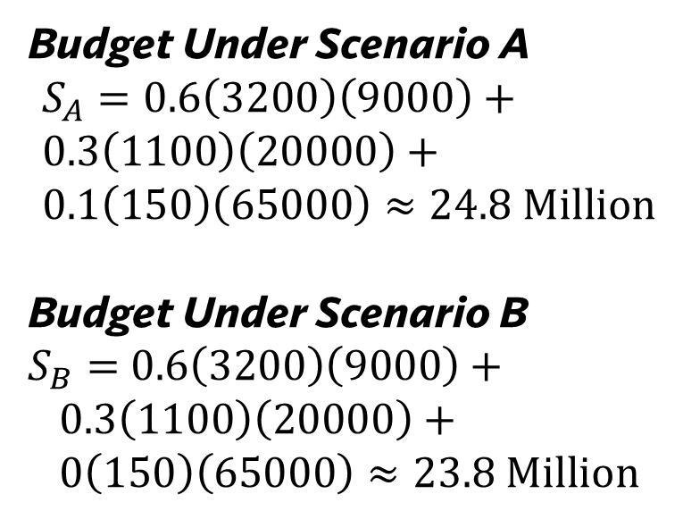
Scenario Analysis In Budget Impact Analysis
Drug | Patients | Costs Per Unit | Market Share
Surgical Procedure | 3,200 patients | $9000 | 0.6
Advanced Biologic | 1,100 patients | $20,000 | 0.3
Gene Therapy | 150 patients | $65,000 | 0.1
Budget Under Scenario A $$S_{A}=0.6\left(3200\right)\left(9000\right)+ \\ 0.3\left(1100\right)\left(20000\right)+ \\ 0.1\left(150\right)\left(65000\right)≈24.8 Million$$ Budget Under Scenario B $S_{B}=$ $0.6\left(3200\right)\left(9000\right)+$ $$0.3\left(1100\right)\left(20000\right)+ \\ 0\left(150\right)\left(65000\right)≈23.8 Million$$
Scenario A
Drug | Patients | Costs Per Unit | Market Share
Surgical Procedure | 3,200 patients | $9000 | 0.7
Advanced Biologic | 1,100 patients | $20,000 | 0.3
Gene Therapy | 150 patients | $65,000 | 0
Scenario B

Slide 21
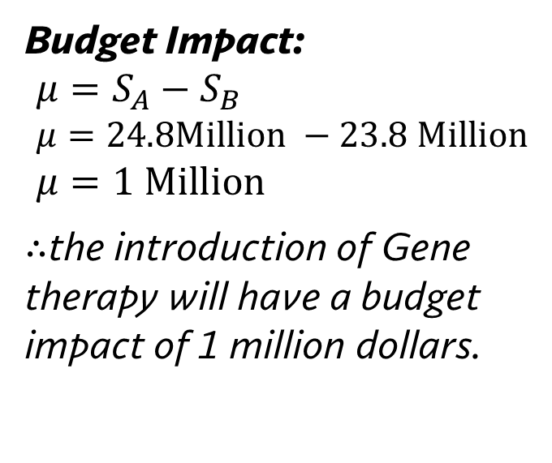
Scenario Analysis In Budget Impact Analysis
Drug | Patients | Costs Per Unit | Market Share
Surgical Procedure | 3,200 patients | $9000 | 0.6
Advanced Biologic | 1,100 patients | $20,000 | 0.3
Gene Therapy | 150 patients | $65,000 | 0.1
Budget Impact: $$μ=S_{A}−S_{B} \\ μ=24.8Million −23.8 Million \\ μ=1 Million$$
$∴$the introduction of Gene therapy will have a budget impact of 1 million dollars.
Scenario A
Drug | Patients | Costs Per Unit | Market Share
Surgical Procedure | 3,200 patients | $9000 | 0.7
Advanced Biologic | 1,100 patients | $20,000 | 0.3
Gene Therapy | 150 patients | $65,000 | 0
Scenario B

Slide 22
Some Notes on Budget Impact Analysis
Often Budget Impact Analysis is conducted with a deterministic sensitivity analysis that varies market shares.
In general, probabilistic sensitivity analysis is not recommended for budget impact analysis as the simulations can often suggest non realistic changes in the budget.
This is important, because its possible to be “overly optimistic” about budget impact (and even argue budget savings) when the underlying substitution patterns are non tenable.

Slide 23
Learning Objectives
In this lecture we will discuss:
An Introduction to Budget Impact Analysis.
Cost Effectiveness League Tables.
Funding Decisions with the League Table
Budget Impact Analysis- Static Models.
Goal of this Lecture:
Introduce Decision Making with ICERs.
Introduce Scenario Analysis and show the basics of budget impact analysis.

